Slide 1
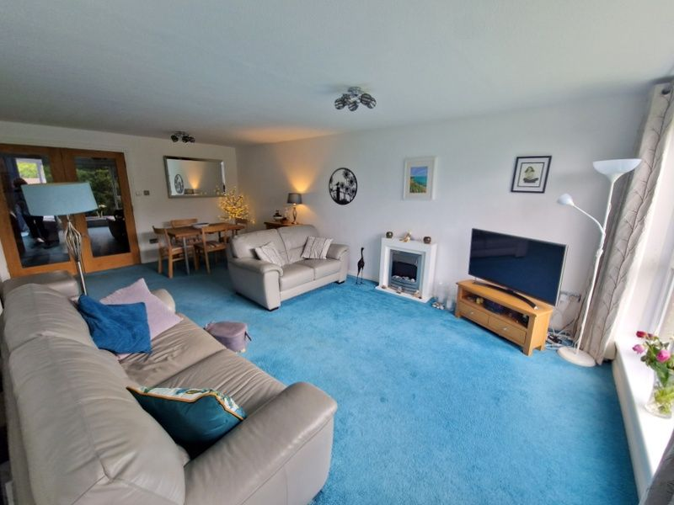
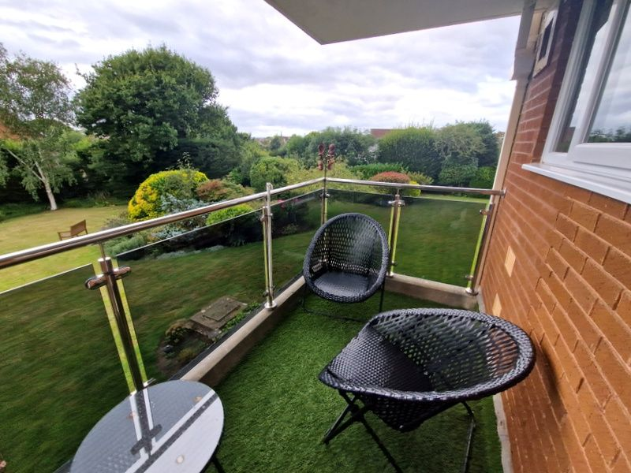
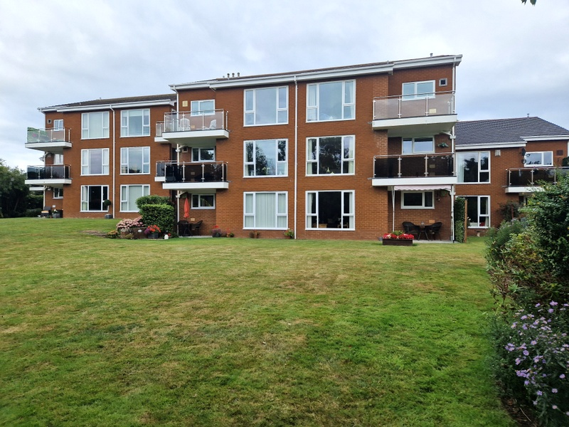
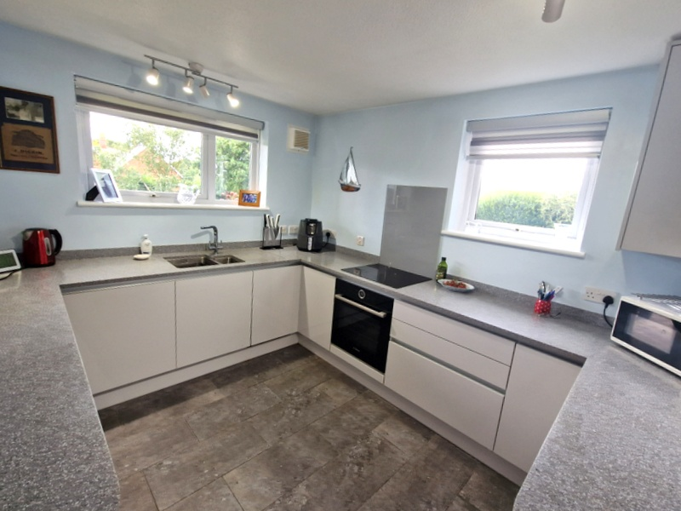
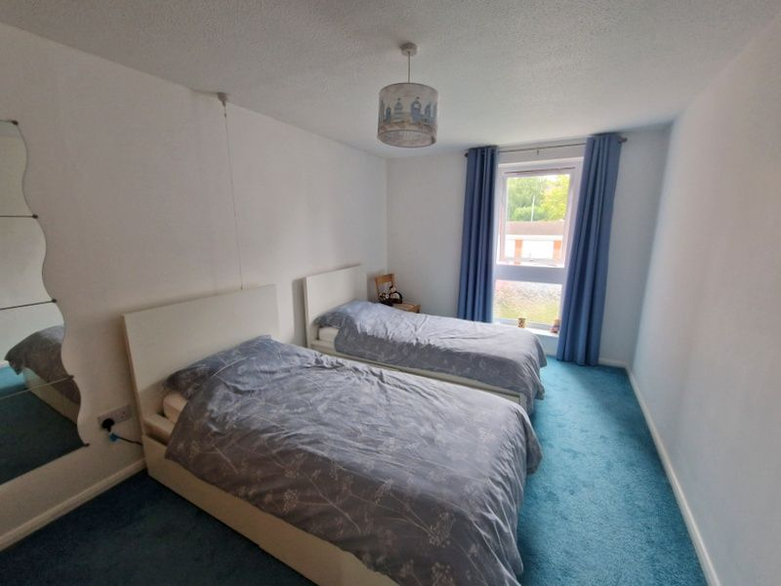
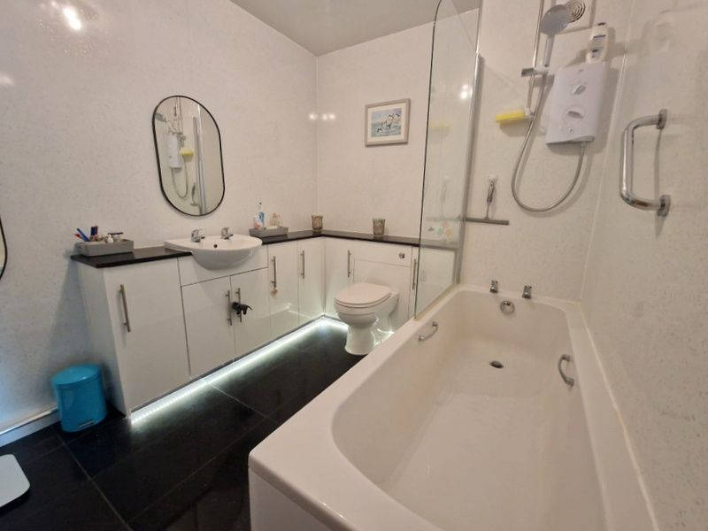
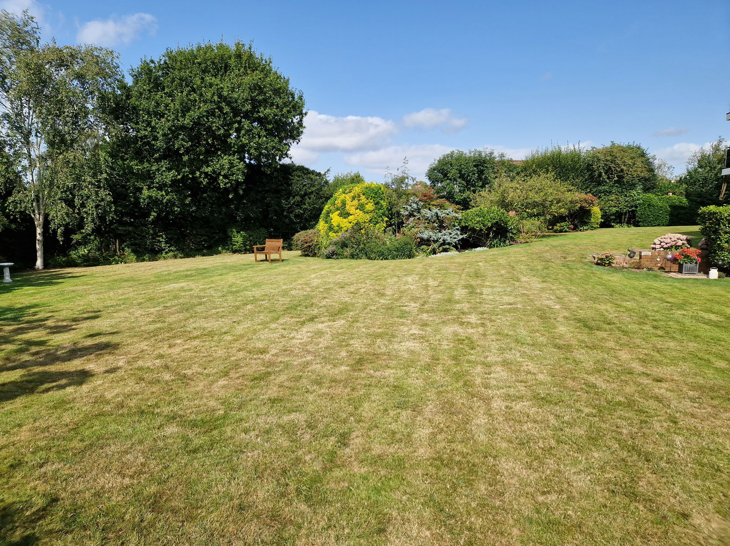
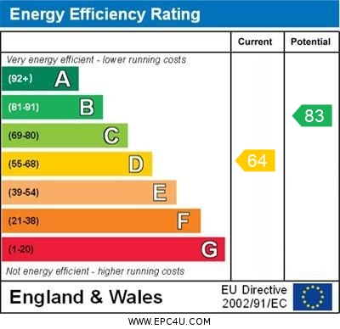
www.pennys.net
Flat 11 Heron Court, 5 Cranford Avenue, Exmouth, EX8 2HP
GUIDE PRICE £269,950
TENURE Leasehold
Beautifully Presented Purpose Built First Floor Apartment Located In A Sought-After Avenues Area Of Exmouth With Bright And Spacious Much Improved Accommodation
Spacious Lounge/Dining Room With Sun Balcony Off * Quality Refitted Kitchen With Range Of Built-in Appliances * Two Double Bedrooms * Stylish Bathroom Suite/Wc * Cloakroom/Wc * Underfloor Heating In Both The Kitchen And Bathroom * Upvc Double Glazed Windows * Beautiful Communal Gardens * Garage * Viewing Strongly Recommended
Pennys Estate Agents Limited for themselves and for the vendor of this property whose agents they are give notice that:- (1) These particulars do not constitute any part of an offer or a contract. (2) All statements contained in these particulars are made without responsibility on the part of Pennys Estate Agents Limited. (3) None of the statements contained in these particulars are to be relied upon as a statement or representation of fact. (4) Any intending purchaser must satisfy himself/herself by inspection or otherwise as to the correctness of each of the statements contained in these particulars. (5) The vendor does not make or give and neither do Pennys Estate Agents Limited nor any person in their employment has any authority to make or give any representation or warranty whatever in relation to this property.
PENNYS ESTATE AGENTS
2 Rolle House, Rolle Street, Exmouth, Devon, EX8 2SN
Tel: 01395 264111 EMail: help@pennys.net

Slide 2
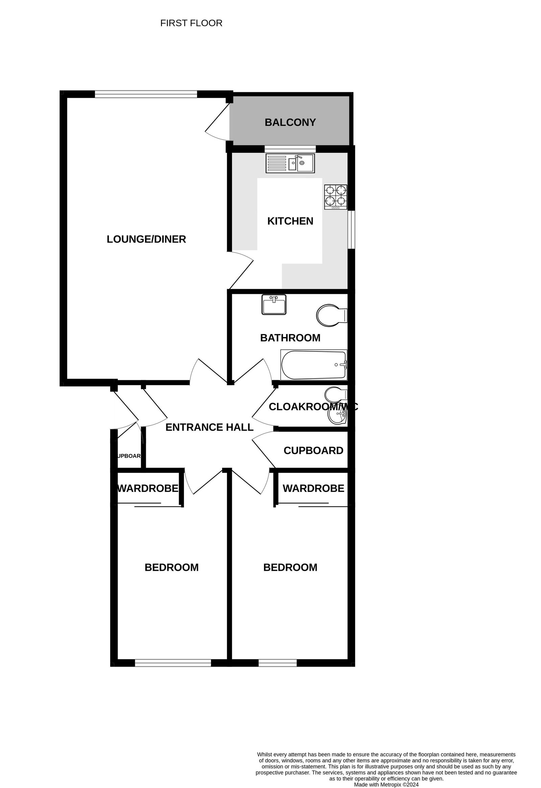
Flat 11 Heron Court, 5 Cranford Avenue, Exmouth, EX8 2HP
THE ACCOMMODATION COMPRISES: Communal entrance with staircase rising to first floor landing, private front door to:
ENTRANCE PORCH: With coat rack, meter cupboard, electric consumer unit, inner door to:
RECEPTION HALL: Glazed panelled double doors to, built-in linen cupboard with light and slatted shelving:
LOUNGE/DINING ROOM: 6.78m x 3.89m (22'3" x 12'9") A bright spacious room with large uPVC double glazed windows taking full advantage of the outlook over the beautifully tended communal gardens, TV point, uPVC double glazed door to SUN BALCONY with artificial grass, glass balustrade. Thermostat control for heating, door to:
KITCHEN: 3.38m x 2.87m (11'1" x 9'5") A stylish refitted kitchen comprising a range of patterned Minerva worktops with matching splashbacks with one and a half bowl single drainer sink unit with integrated drainer and mixer tap, cupboards, drawer units, integrated fridge/freezer and washer/dryer beneath worktops, integrated dishwasher; wall mounted cupboards and built-in induction hob with glass splashback and built-in oven below, uPVC double glazed windows to side and rear aspects, ceiling spotlighting, underfloor heating.
BEDROOM 1: 4.65m x 2.9m (15'3" x 9'6") With built-in wardrobes and adjoining shelved wardrobe, thermostat control for heating, uPVC double glazed window to front aspect.
BEDROOM 2: 4.65m x 2.72m (15'3" x 8'11") Another good size double bedroom with built-in wardrobes, thermostat control for heating and uPVC double glazed window to front aspect.
BATHROOM/WC: 2.84m x 2.13m (9'4" x 7'0") Stylishly fitted with splashback walls and tiled flooring, underfloor heating, bath with Mira shower unit over and shower splash screen, wash hand basin set in display surface with cupboards beneath with attractive plinth lighting, WC with concealed cistern and push button flush, chrome heated towel rail, Dimplex electric wall heater.
CLOAKROOM/WC: Stylishly refitted comprising wash hand basin set in display surface with matching splashback, cupboards beneath, mixer tap, wall mounted cupboards over, WC with concealed cistern and push button flush, extractor fan, wall mirror.
OUTSIDE: Located in a sought after location, the flat enjoys wonderful communal gardens which are mainly laid to lawn with colourful flower and shrub beds. The property benefits from its own single garage in a block with an up and over door, communal drying and dustbin area and electric car charging point.
TENURE & OUTGOINGS: The flat is leasehold and benefits with a share of the freehold. Service Charge: £145 per calendar month.
Mortgage Assistance: We are pleased to recommend Meredith Morgan Taylor, who would be pleased to help no matter which estate agent you finally buy through. For a free initial chat please contact us on 01395 264111 to arrange an appointment. Your home may be repossessed if you do not keep up repayments on your mortgage. Meredith Morgan Taylor Ltd is an appointed representative of Openwork Limited, a trading style of Openwork Ltd which is authorised and regulated by the Financial Conduct Authority (FCA).
FLOOR PLAN:

